Slide 1
Sidste undervisning

Slide 2
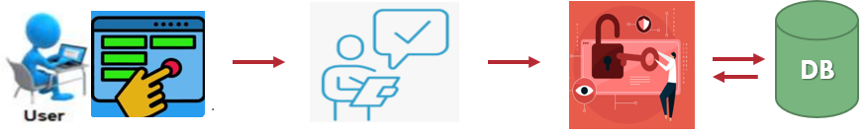
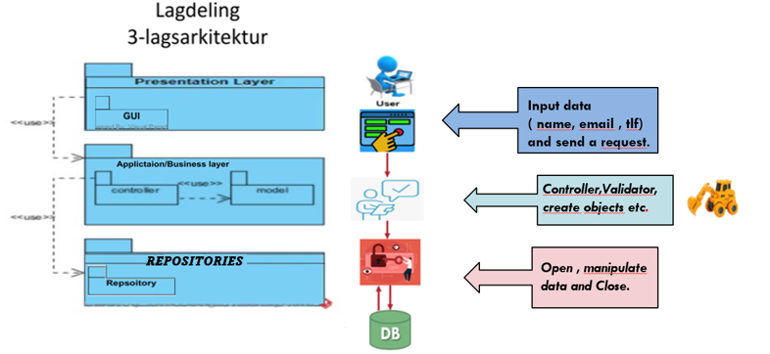
Lagdeling 3-lagsArkitektur

Slide 3
Case study 1 : project management system
As a customer, I will be able to place and view all the projects that I placed so that I can all the time be updated about their status.
As a manager, I will be able to manage projects into tasks to allow employee to work on.
As an employee, I will be able to see details of all projects and their associated tasks, so I can work on one of them.

Slide 4
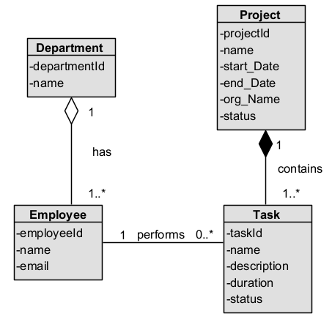
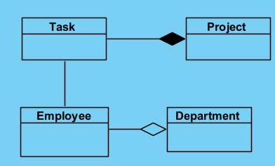
Analyse klass diagram

Slide 5
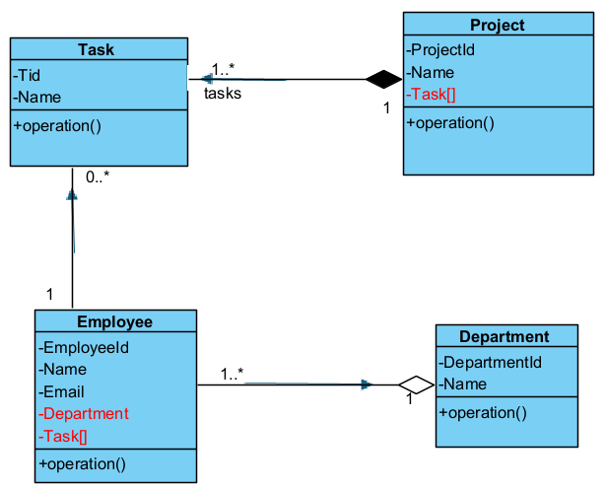
Design klass diagram
View all my tasks.
See the tasks for a specific project
View the details of who is working on a project
View the department , an employee is working at

Slide 6
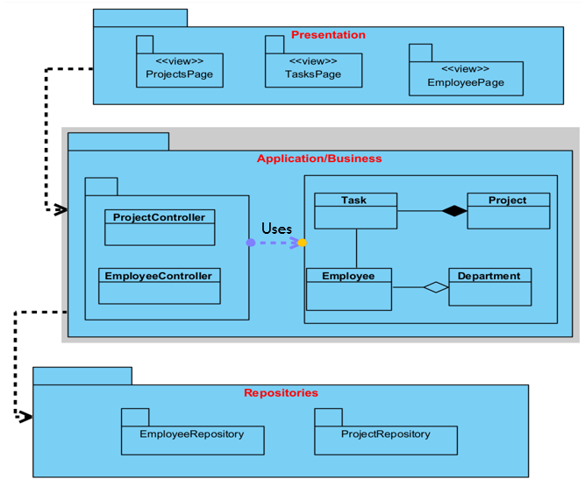

Slide 7
Design sequence diagram

Slide 8
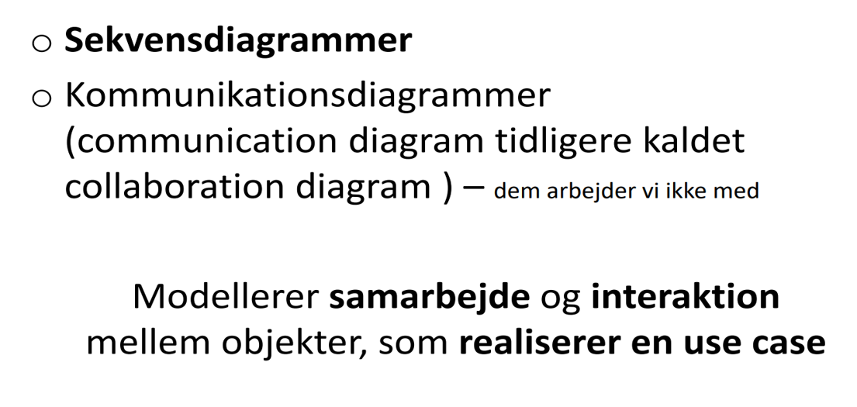

Slide 9
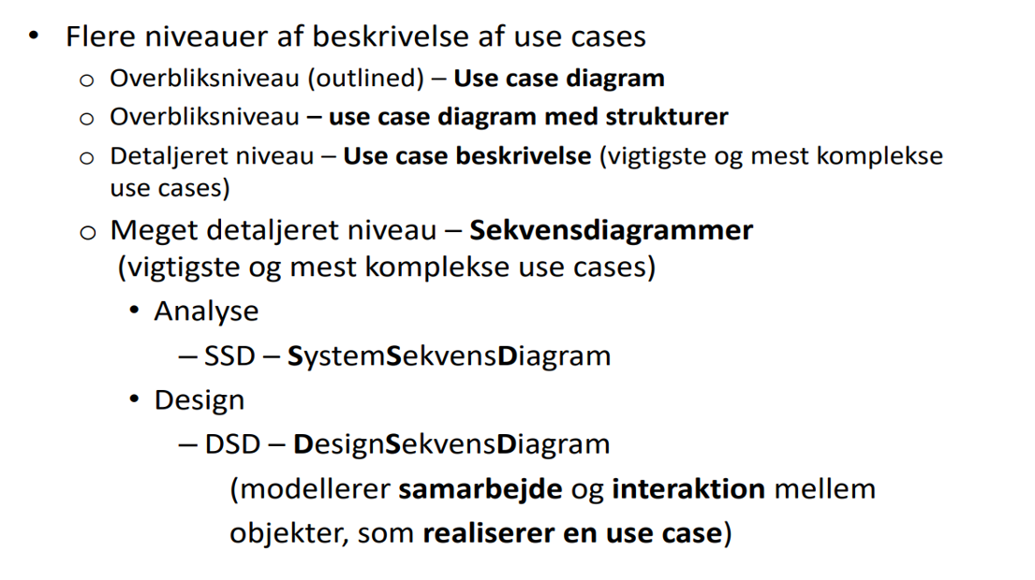
USE CASE

Slide 10
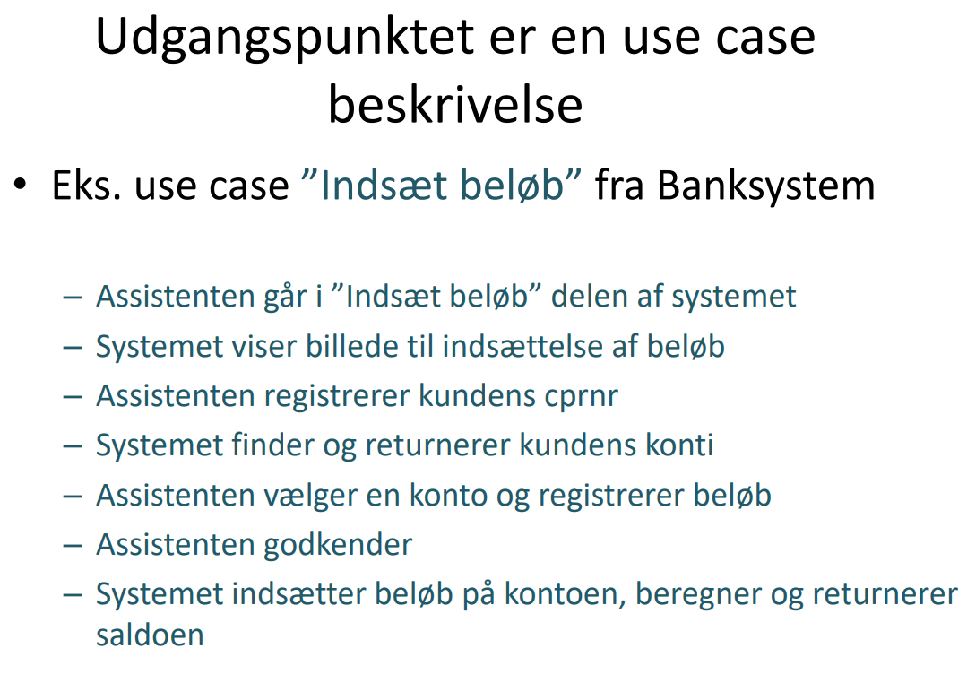

Slide 11
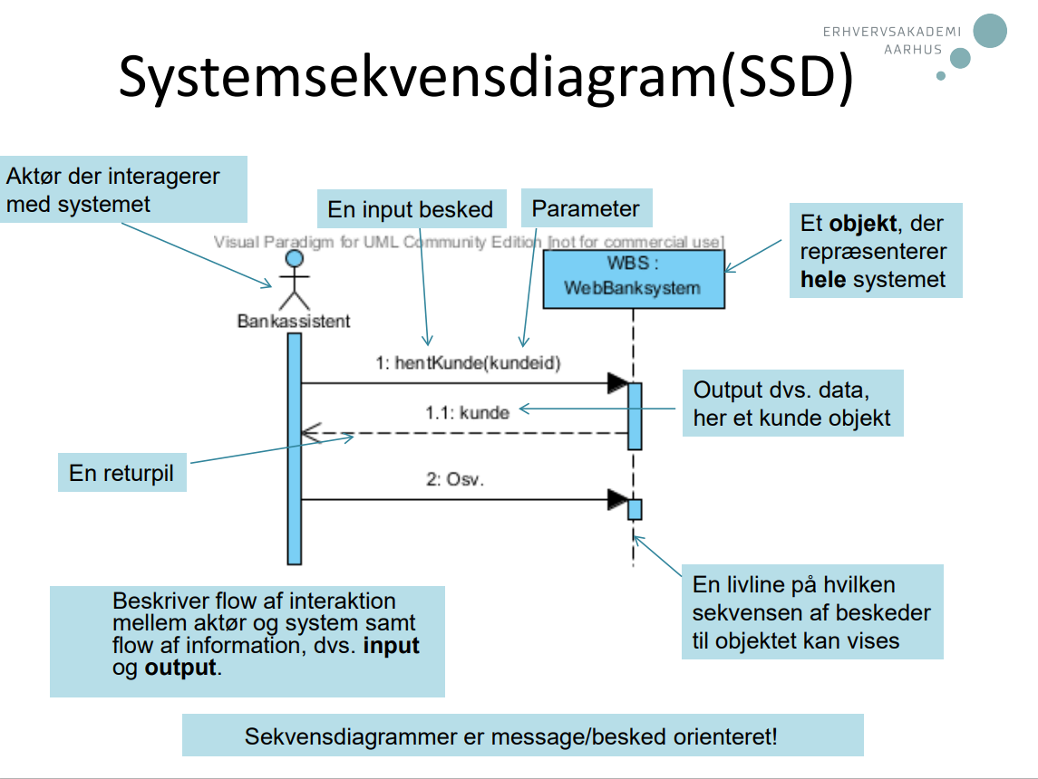
System sequence diagram

Slide 12
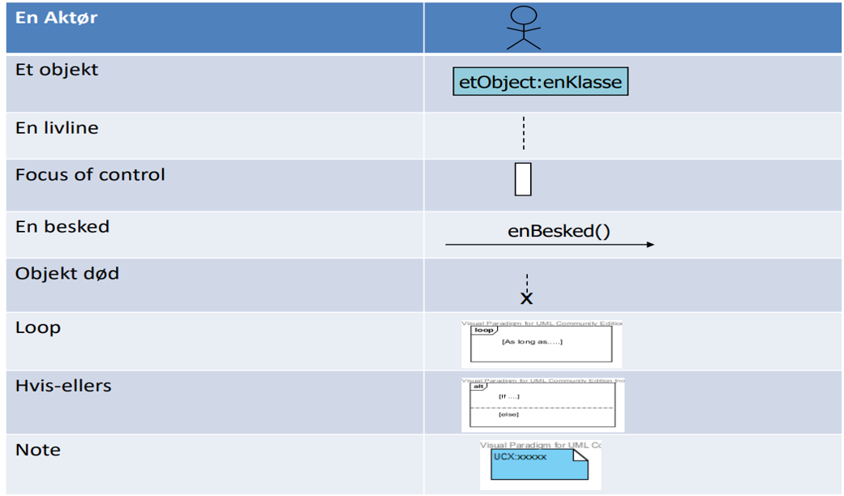
SSD NOTATION

Slide 13
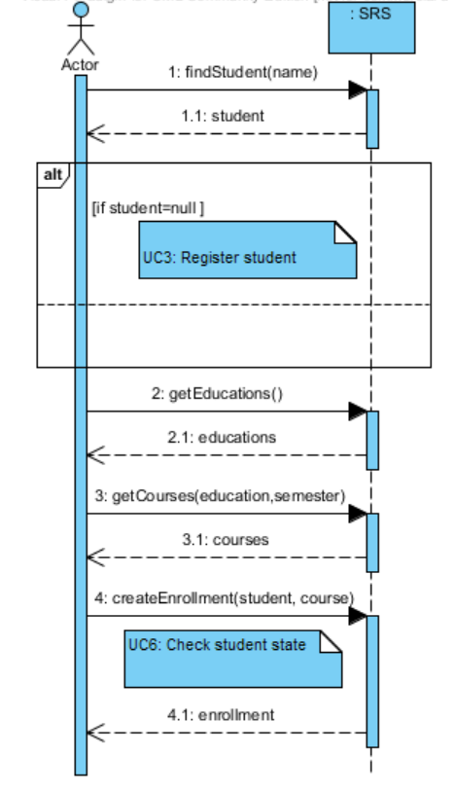
SSD
Opgaven
I jeres gruppe, tag udgangpunktet i use case ”Enroll course” side 17 i noten OG diskuter den SSD .
Forstå hvordan diagrammet modellerer flowet af beskeder til systemet, input, output osv.

Slide 14
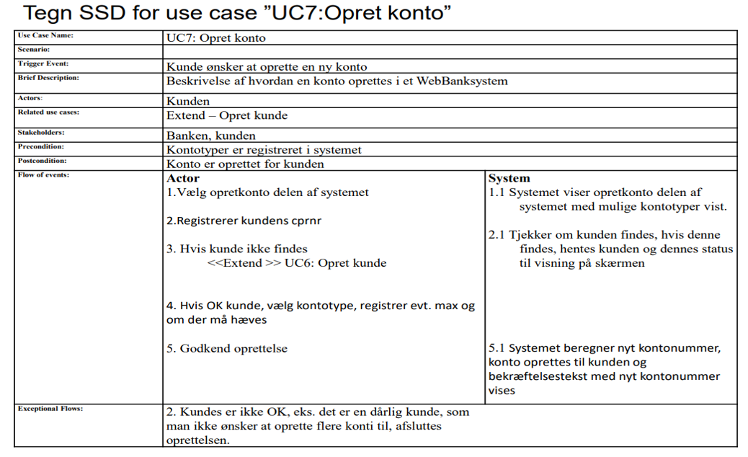
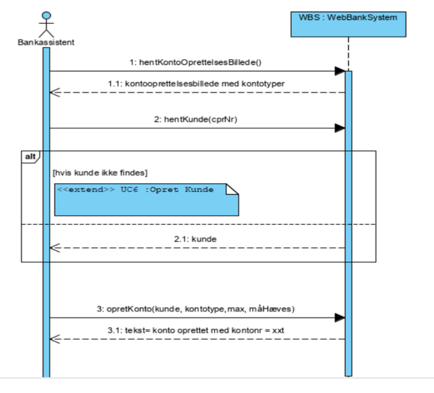
Hvordan tegner man en SSD ?
Identificer og tegn skridt for skridt input beskeder, evt. betingelser, input og output, parametre…osv

Slide 15
DESIGN SEQUENCE DIAGRAM

Slide 16
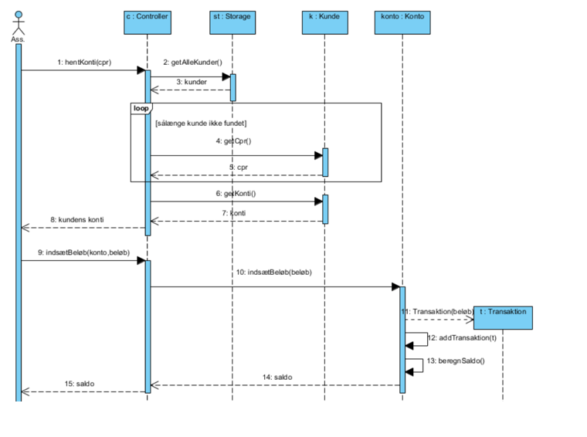
DESIGN SEQUENCE DIAGRAM

Slide 17
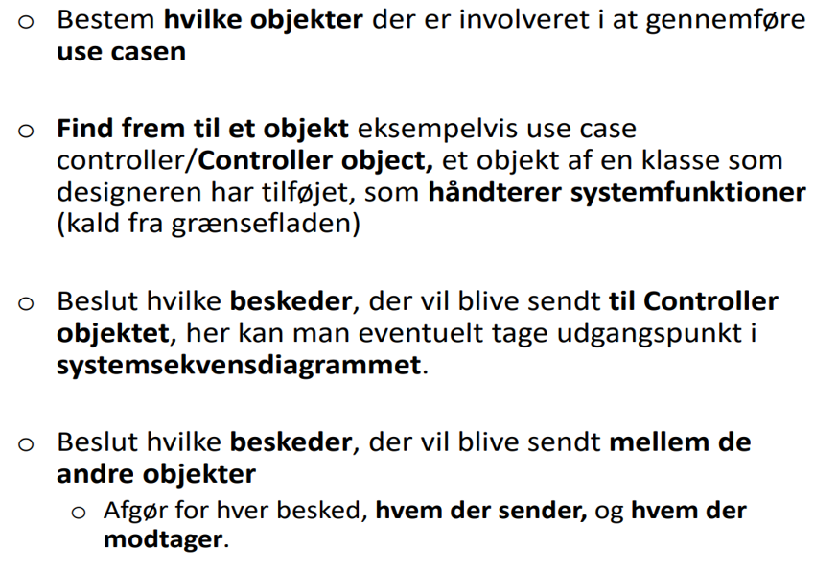
Hvordan bygger man en design sequence diagram

Slide 18
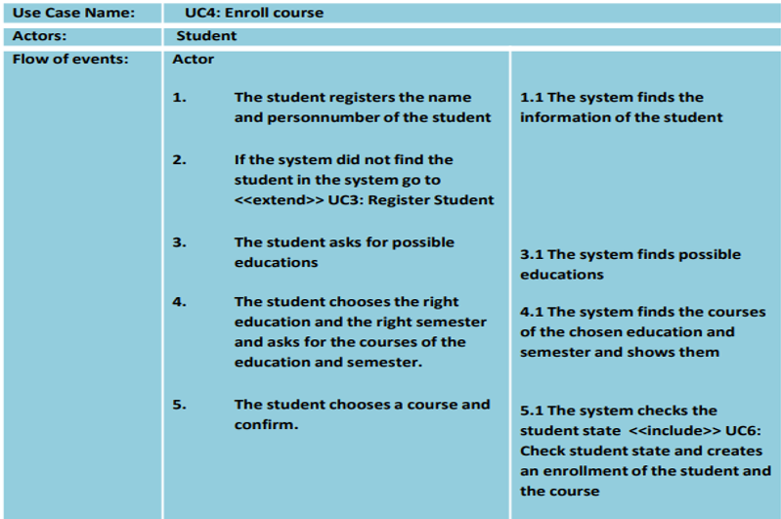

Slide 19
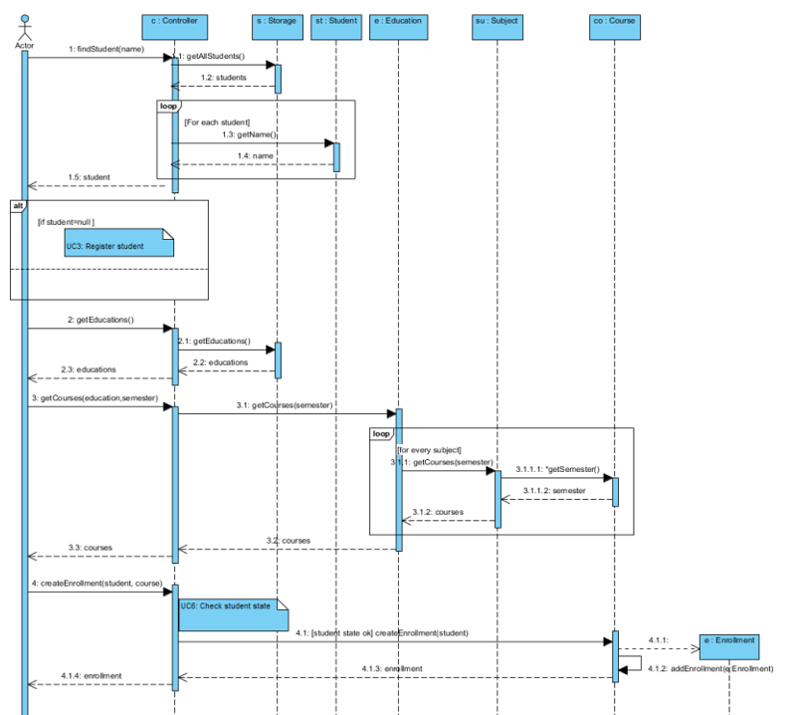

Slide 20
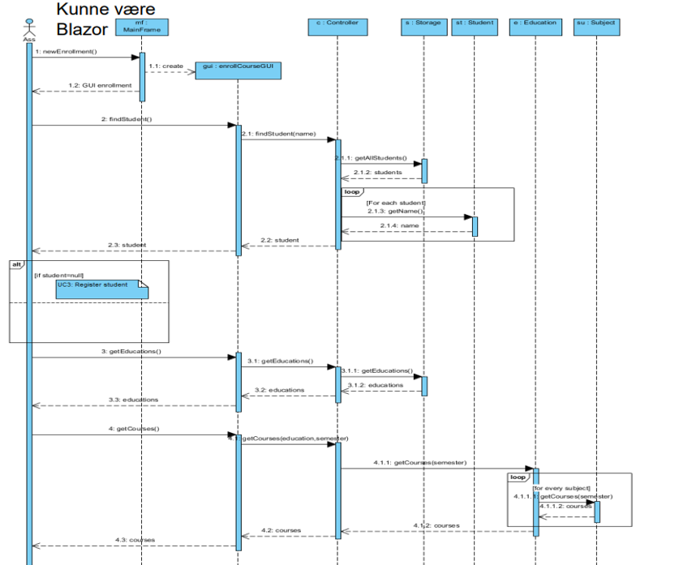
SKOLE ADMINISTRATION SYSTEM

Slide 21
Analyse klass diagram-
project management system

Slide 22
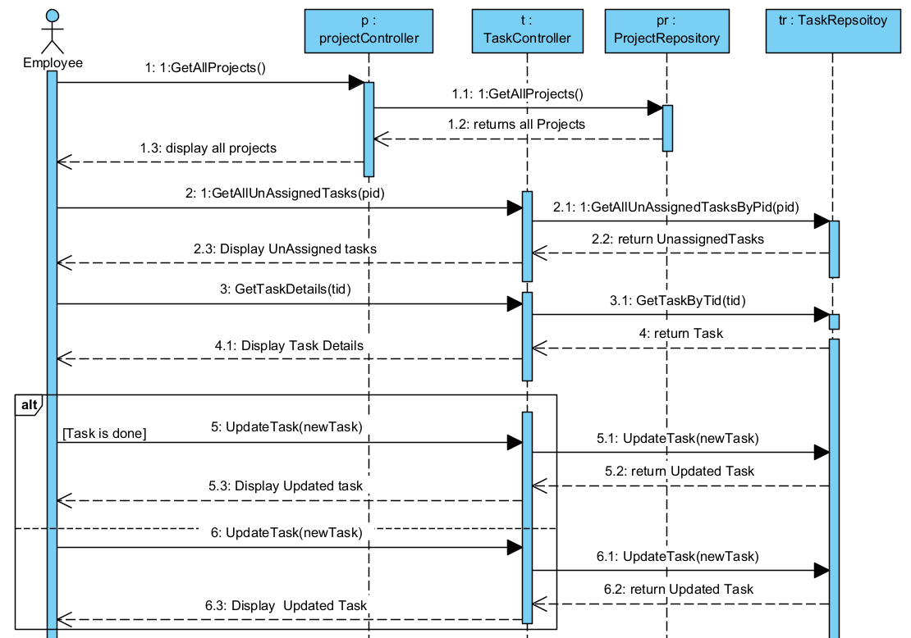
Use case : Perform a task

Slide 23
